Slide 1
Error detection and correction

Slide 2
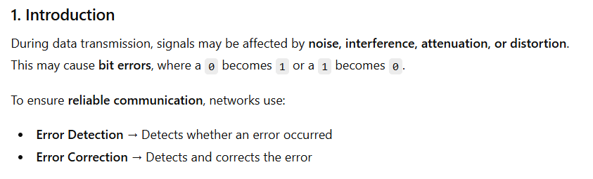
Error Detection and Error Correction

Slide 3
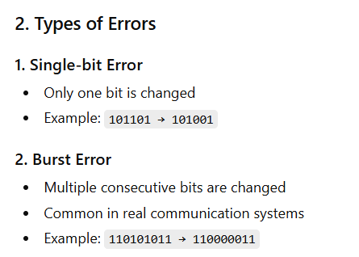
Error Detection and Error Correction

Slide 4
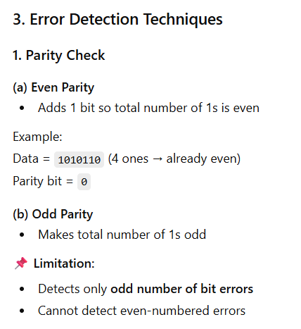
Error Detection and Error Correction

Slide 5
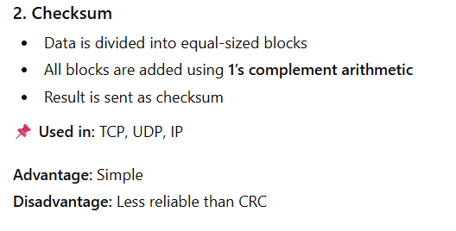
Error Detection and Error Correction

Slide 6
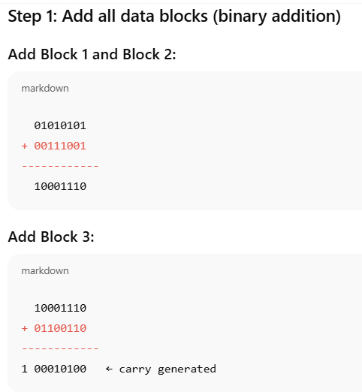
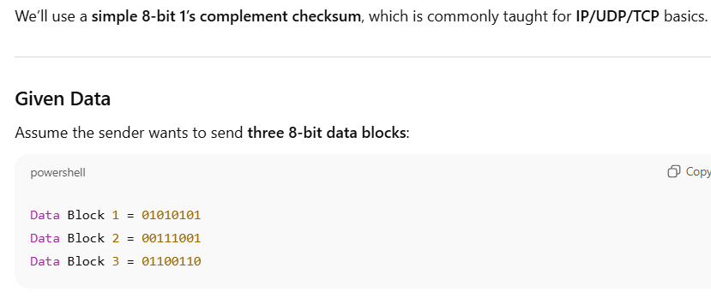
Checksum example

Slide 7
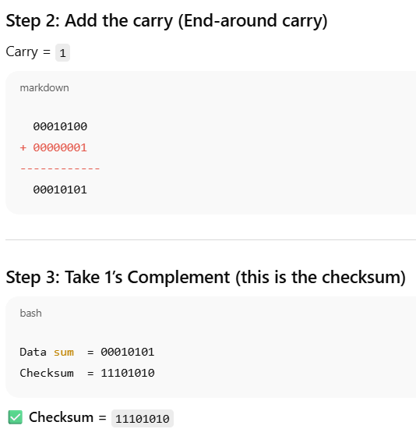
Checksum example

Slide 8
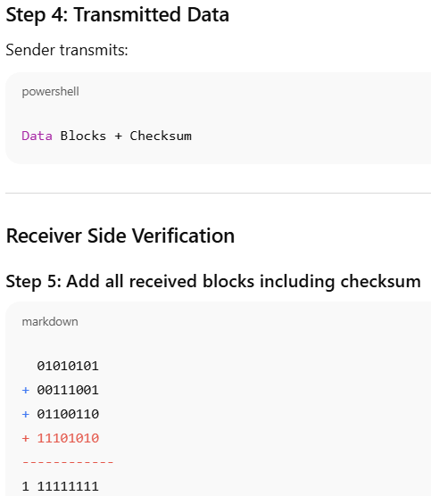
Checksum example

Slide 9
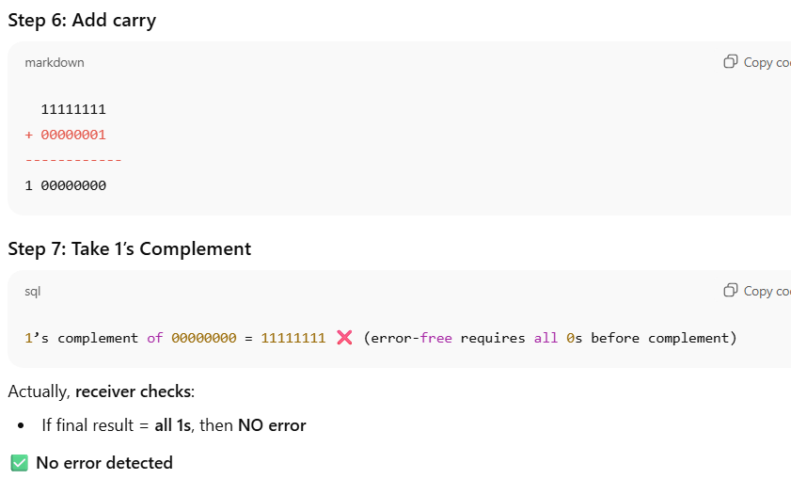
Checksum example

Slide 10
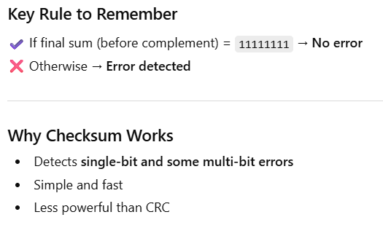
Checksum example

Slide 11
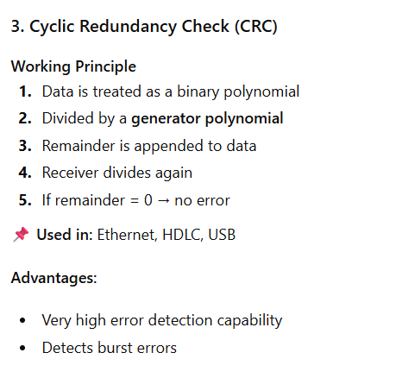
Error Detection and Error Correction

Slide 12
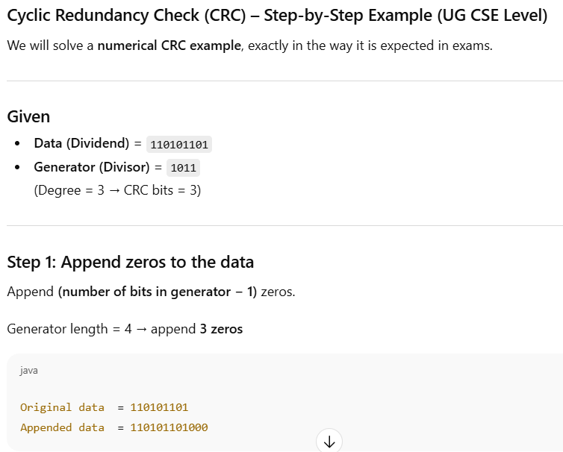
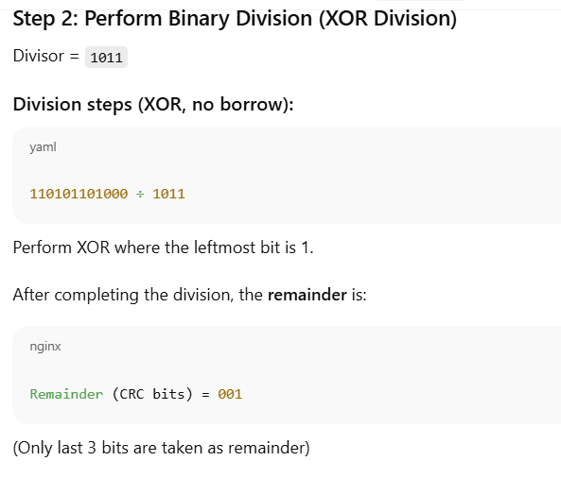
Cyclic Redundancy Check (CRC) example

Slide 13
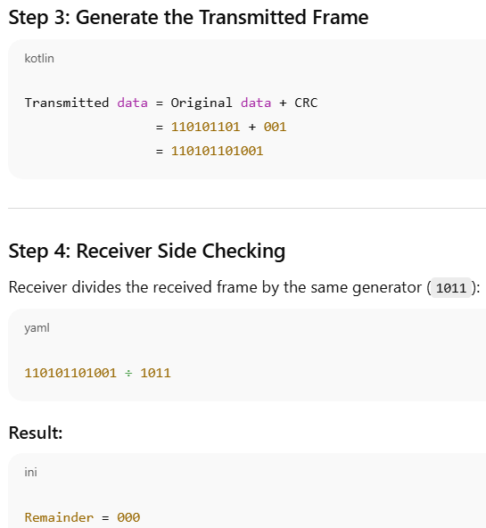
Cyclic Redundancy Check (CRC) example

Slide 14
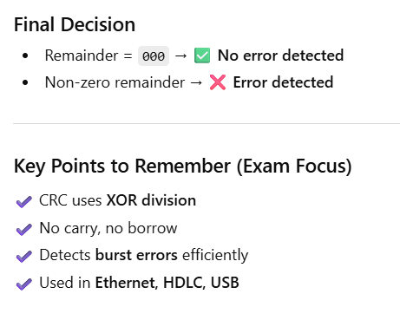
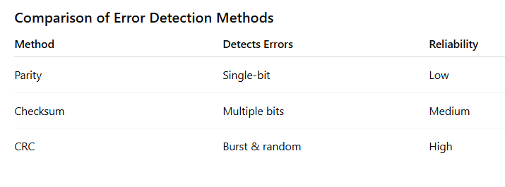
Cyclic Redundancy Check (CRC) example

Slide 15
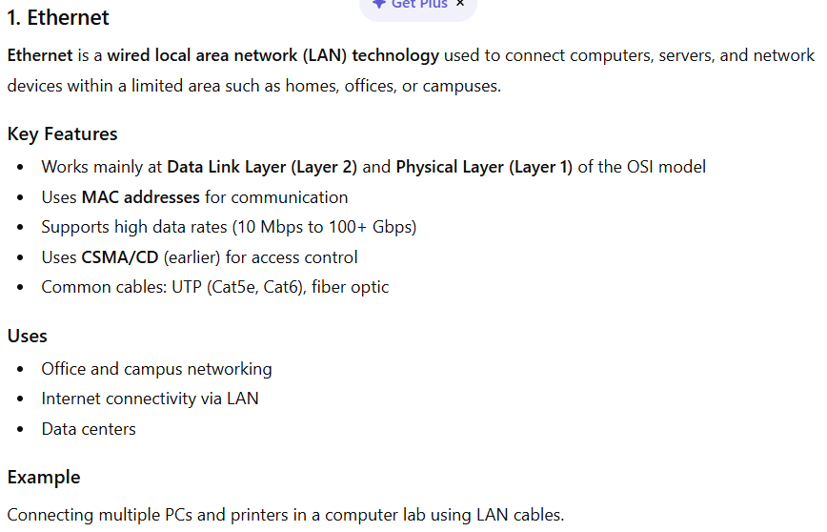
Ethernet, HDLC, USB?

Slide 16
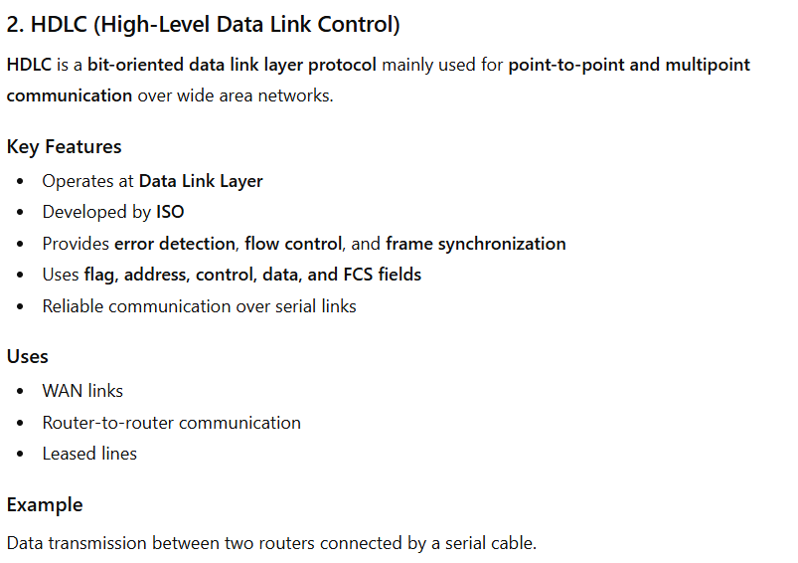
Ethernet, HDLC, USB?

Slide 17
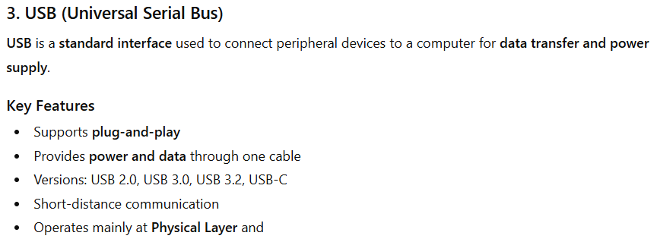
Ethernet, HDLC, USB?

